Slide 1
A brain-inspired improvement to model-based reinforcement learning

Slide 2
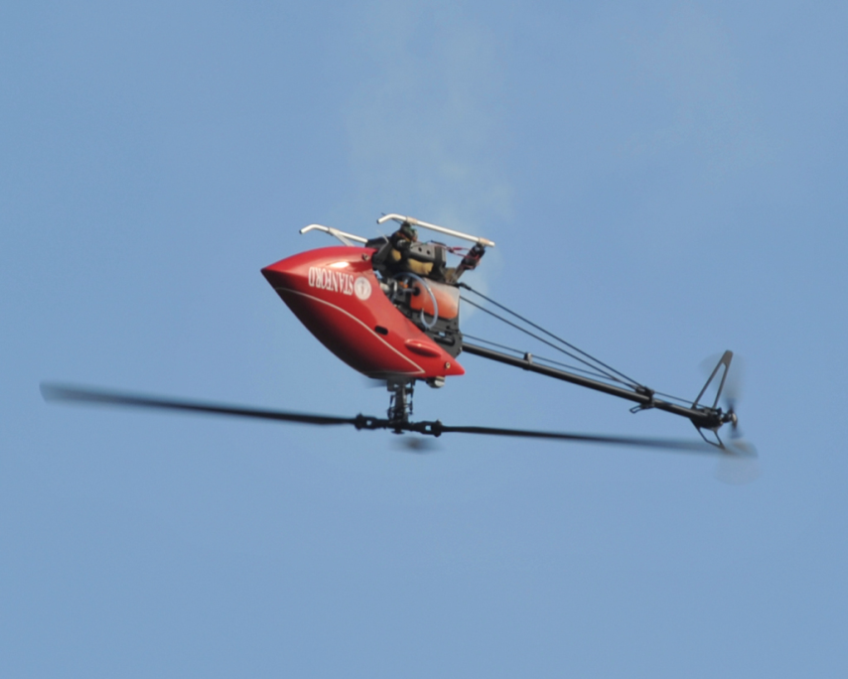
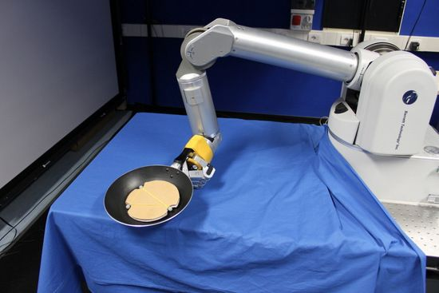
Reinforcement Learning Algorithms
RL algorithms mimic dopamine-driven learning mechanisms in the brain
Useful tools in neuroscience
Lots of engineering applications
Kormushev et al. (2013)
Ng et al. (2006)
Notes:
Reinforcement learning algorithms provide a model for how an intelligent agent can learn from its environment.
They’re inspired by dopamine-driven learning mechanisms in the brain, and that makes them useful tools in neuroscience. But they have a wide range of engineering applications when we’re talking about artificially intelligent agents like robots or computer programs.

Slide 3
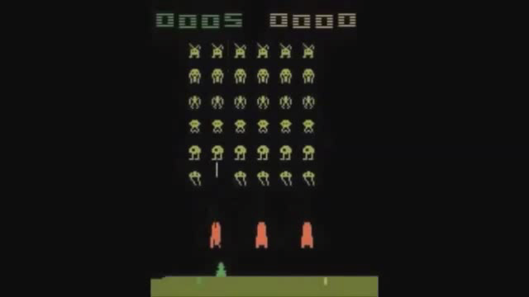

RL-based agent playing Atari games - Mnih et al. 2015
RL gives artificial agents (robots, computer programs) a way to learn optimal behavior
As opposed to being programmed with that behavior
Notes:
This is a popular example. These guys wrote a computer program that used a reinforcement learning algorithm to learn to play Atari games. What’s really interesting here is that the agent is learning to play these games. It would be fairly easy to write a computer program that plays Space Invaders. But that program wouldn’t also be able to play Breakout – you’d have to write a separate program for that.
In contrast, this agent wasn’t explicitly programmed to play either game. Instead it was programmed with a way to learn, and then it learned to play both games.

Slide 4
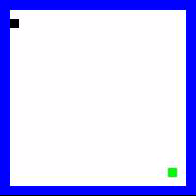
Model-based Reinforcement Learning
Example task:
Agent (black dot) has 4 actions: up, left, right, down
Agent uses its experiences to build a model of the world
Model predicts the result of taking action ‘a’ in state ‘s’
Important information (ie. the goal state) propagates through the model and is used in decision making
MB-RL is analogous to goal-directed (rather than habitual) behavior
- Daw (2012)
Negative reward for hitting walls
Big reward for finding goal
Notes:
There are several families of RL algorithms, but here I’m focusing on model-based reinforcement learning.
Here’s a simple example to illustrate how model-based RL works.
The black dot is our agent. In the beginning, the only thing he knows is that he has four actions available: up, left, right, and down. He must learn how to use these actions to maximize his reward.
What he doesn’t know yet is that if he crashes into a wall he receives a negative reward (a punishment), and if he finds the green goal he gets a big reward.
As he explores, he learns things. Some actions take him to a new state in the arena, but some actions executed from certain states will make him hit a wall.
He’s constantly building up a model of the world – basically the model remembers what happens when you execute certain actions from certain states.
When he learns something important – like when he discovers the goal, for example – that information is propagated through the model so that it can become part of the agent’s decision making from any state.
That means that the agent is doing something that resembles planning – for that reason, MBRL is often compared to goal-directed behavior (as opposed to habitual behavior)

Slide 5
Model-based Reinforcement Learning
Agent is exploring
(hitting walls, etc.)
Agent has found optimal solution
Goal discovered
Notes:
This chart shows the agent’s cumulative reward during that simulation on the previous slide.
During the first part, the agent is learning and exploring, and frequently crashing into walls – so the cumulative reward steadily drops.
In the last section, the agent has figured out the task and is just racking up the rewards. We say that he’s converged to an optimal solution.

Slide 6
Issues with model-based RL
Scaling to large problems
Updating a large model is computationally (cognitively) demanding
Adapting to changes
Old information must be un-learned & replaced (computationally demanding)
Has been argued that animals probably prefer habit-based choice over MBRL mechanisms
Daw et al. (2005), Zendehrouh (2015)
Notes:
There are some issues in MBRL.
It has a hard time scaling to large or complicated problems. In a large problem, information has to be propagated through a very large model, and this can take a lot of computational (or cognitive) effort.
Adapting to changes in the environment can be tough as well. Old information must be un-learned and replaced with new information, and again this can be computationally demanding.
These issues are significant enough that some researchers have proposed animals must not use these goal-directed, model-based mechanisms very often. They say that animals must rely on habit-based methods wherever possible because making decisions based on habit is so much cheaper and easier.

Slide 7
A more brain-like RL
MB-RL tracks what happens when we take each action from each state
States are like hippocampal place fields
Notes:
With that background information, I’ll move on to explain what we’ve done so far.
The point of the model in MBRL is to predict what happens when we take a certain action from a certain state. In our simple example, the states are all the positions that our agent can occupy. Each of these little squares in an individual state.
We can think of these states as being like hippocampal place fields.

Slide 8
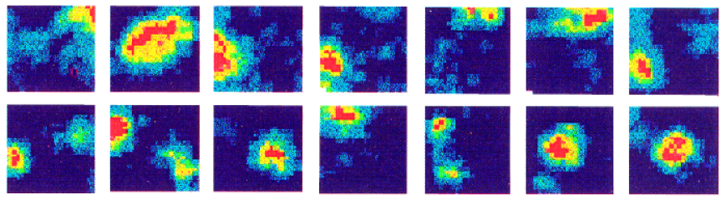
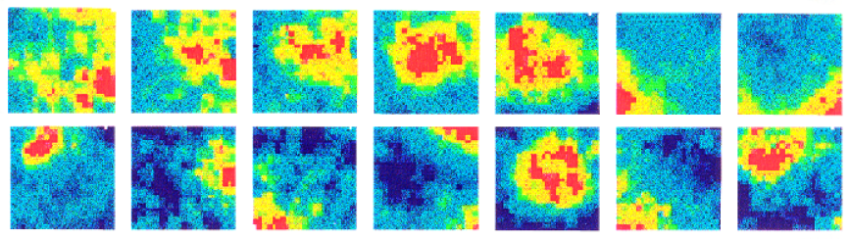
Place fields: Dorsal vs. Ventral Hippocampus
Dorsal
Ventral
Jung et al. 1994
Notes:
The hippocampus contains cells called place cells, which are associated with particular places in space, and which fire each time the animal goes to that place.
These recordings are taken from a rat in a square enclosure. The red areas are areas of rapid firing – you can see different neurons firing at different places in the enclosure.
But the hippocampus seems to have a hierarchical representation of space.
At the dorsal end of the hippocampus the place fields are quite small – they respresent specific places.
At the ventral end, the place fields are much less specific and represent general regions of space.

Slide 9
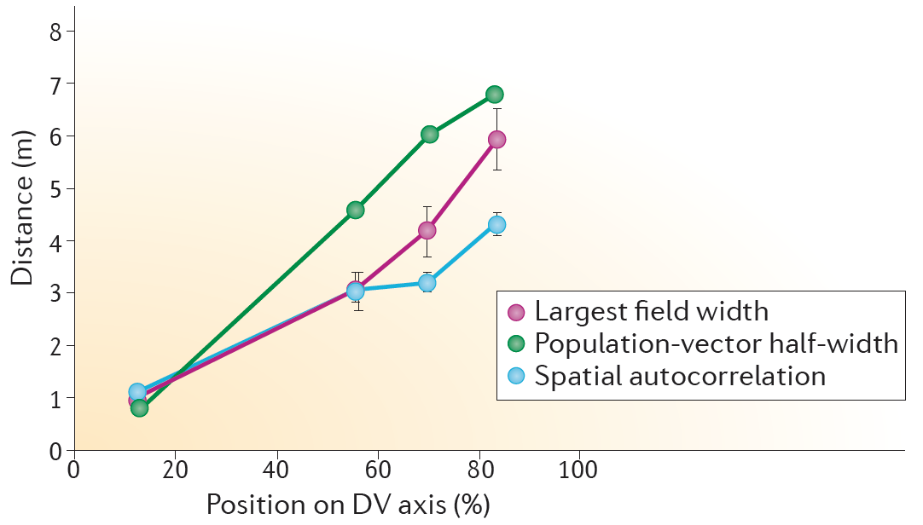
Place fields: Dorsal vs. Ventral Hippocampus
Strange et al. 2014
Notes:
Here’s another chart showing that the size of the place fields increases smoothly as we move from the dorsal to the ventral hippocampus.

Slide 10
New RL model
“Ventral”
“Dorsal”
Notes:
So we’re working on a new RL algorithm that incorporates this hierarchical representation of space.
We create a layered RL model – the first layer uses the individual states in the environment directly.
The next layer up groups four of these states together to make a macro state at that level.
The next layer groups four of those macro states to make an even bigger macro state, and so on.
So we now have this gradient of spatial scale, just like we see along the dorsal-ventral axis of the hippocampus.

Slide 11
New RL model
One MB-RL running at each level
Higher levels set goals
Lower levels plan the route to the goal
Dorsal hippocampus is involved in wayfinding – Hartley et al. (2003)
Use A* algorithm here
“Ventral”
“Dorsal”
Notes:
Separate model-based RL algorithms are running at each of these levels, and they interact during decision making.
In general, the higher levels set a goal, and the lower levels coordinate to plan a route to that goal. There’s some neuroscientific credibility to this – Hartley et al identified the dorsal hippocampus as being involved in accurate wayfinding.
In our implementation, an A* algorithm is used to do route planning at each level.

Slide 12
New RL model
At higher levels, rewards are calculated at state transitions
Lower levels can send negative reward signals to higher levels, if the route to a goal is difficult
At lowest level, rewards come from the environment as usual
Notes:
This slide shows how rewards work in this layered model. The lowest level acts in the world directly and receives rewards and punishments from the environment just like in standard MBRL.
At higher levels, rewards are calculated every time there’s a transition between states at that level.
In addition, lower levels can send negative reward signals to the layer above if the route to a goal is undesirable. This two way communication is important – the higher levels set goals and communicate them down, and the lower levels can communicate back up to let the higher level know when a goal is unrealistic.

Slide 13
New RL model
Higher levels take the burden of keeping an updated model
But at this level there’s only a few states to update
Lower levels only need enough information to do pathfinding
Overall fewer model interactions (compared to standard MB-RL)
Notes:
The advantage to this layered structure is that the burden of maintaining an accurate model is shifted from the lower levels to the higher levels.
The higher levels need to keep an up-to-date model of the world, but at these levels the world only contains a few states, so model maintenance is easy.
The lower level model only needs enough information to do pathfinding – it doesn’t need to worry as much about propagating reward information through the model.
The upshot of this is that the new approach requires fewer interactions with it’s model(s), compared to standard MB-RL.

Slide 14
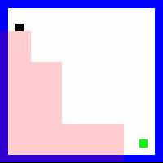
New RL model
Level 4: “Go here”
Level 3: “Go here first”
Level 2: “Go here first”
Similarly, rodent place cells associated with a planned route can fire in expectation
- Johnson & Redish (2007), van der Meer & Redish (2009)
Notes:
Here’s an illustration of the new model working. The pink regions show the agent’s planned route.
In this example, the highest level (level 4) has set a goal, and levels 3 and 2 have identified sub-goals on the route to that goal.
This may be analogous to an effect observed in rats: when the rat plans to follow some path, place cells on that path fire in anticipation, even though the rat hasn’t visited those places yet.

Slide 15
Comparing standard MB-RL to New Method
Notes:
Here’s a comparison of the multilevel method and the standard MB-RL approach. This chart shows the results of training in that same square arena we saw earlier.
The bottom portion shows the cumulative reward – the multilevel RL and the standard RL perform almost identically.
The top portion shows the number of times each method accessed its model – either to do an update, or to use it in pathfinding in the case of the multi-level approach. This represents the computational or cognitive load imposed by the learning.
When the standard RL finds the goal, it does a ton of work to propagate that information back through its model. Basically what it’s doing is precomputing the best paths from each known state in light of the new reward information. The advantage of the standard approach though is that once that work is done, it’s pretty much got the task figured out and so there’s very few model updates required afterwards.
The multi-level approach doesn’t require extra work after finding the goal, but it does continue to use its models for pathfinding after that, so it continues to use cognitive resources and eventually uses more than the standard approach.
This doesn’t look great for the new multilevel approach, but this task was static. The agents ran through the same empty arena every time, nothing ever changed. That may not be a realistic situation. Animals in the real world have to adapt to change all the time.

Slide 16
Comparing standard MB-RL to New Method
Switch from open arena to hairpin maze after 2000 steps
Watch how agents respond
Notes:
So now we let the agents train in the open arena for 2000 steps, and then we switch them to this hairpin maze, and see how well they can adapt.

Slide 17
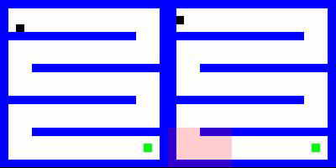
Comparing standard MB-RL to New Method
Switch from open arena to hairpin maze after 2000 steps
Standard MB-RL
Multi-level MB-RL

Slide 18
Comparing standard MB-RL to New Method
Notes:
On the bottom half of this chart we see that the multi-level approach adapts to the new environment faster than the standard approach. We see that in the videos on the last slide.
What we didn’t see in the video was that the cognitive load of the standard approach skyrockets after the environment is switched. That’s because it’s frantically trying to update it’s model with the new information as it constantly bashes into walls it’s not expecting.
The multi-level approach, on the other hand, adapts to the new environment without needing any extra cognitive resources. That’s because the higher layers have relieved the lower layers of the burden of updating their models as rigorously as the standard RL does.

Slide 19
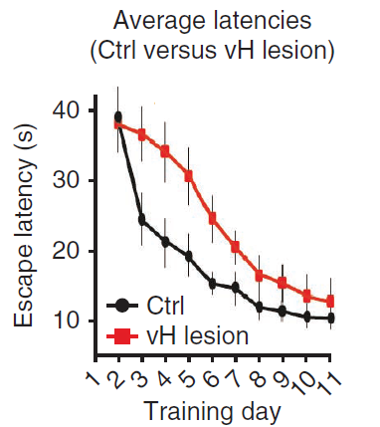
Effect of Removing ‘Ventral’ Layers
Water maze escape latencies (Ctrl vs. vH lesion)
Lesions to rodents’ ventral hippocampus cause delayed learning
Ruediger et al. (2012),
de Hoz et al. (2005, 2014)
Ruediger et al. (2012)
Notes:
We can look at what happens when some of the higher layers are removed from our multi-level model.
That effect has been studied in rodents. These guys had mice doing a water maze task. They found that mice with damage to the ventral hippocampus (the section with larger place fields) still learned the task, but they learned more slowly than controls.
This could indicate a limit on the amount of cognitive resources the mouse is able to use in updating it’s lower level models.

Slide 20
Effect of Removing ‘Ventral’ Layers
Removing higher levels delays learning
Ultimately the optimal solution is still reached
Notes:
It turns out we see the same effect if we remove some of the higher layers from our model. This chart shows cumulative reward in that same maze-switching task as before. The three agents shown here had various numbers of their higher layers removed. The final slopes of all three lines are similar, showing that all eventually solved the task, but the ones with higher layers removed solved it more slowly.

Slide 21


Future Directions
A suboptimal path
Confusion when a boundary transects a high-level state
Notes:
There’s a number of avenues to explore in the future. For now, there are still some bugs to be worked out. For example, the agent on the left learns the optimal solution to this maze if he’s trained on it, but if he’s trained on the open arena and then switched to this maze he settles on the sub-optimal path shown here.
The agent on the right is confused because he assigns high value to the higher-level state shown in red (because technically you can reach the goal from there). This causes him to run down the dead-end path to get to the high-value state. However, because this state is transected by a boundary, it matters which part of the state you reach. The algorithm currently has no way of dealing with that.

Slide 22
Future Directions
High-level states should be learned instead of defined a-priori
Would help solve the problem on previous slide
Introduce ‘contexts’
When the environment changes (a new context), the old model should be saved for later recall
Introduce a loose-switch mechanism
Better response to changing rewards

Slide 23
Future Directions
Replace A* with something else
that can handle stochasticity
Introduce elements of ‘Hierarchical RL’
Hierarchy in action space as well as state space

Slide 24
References
Daw, N.D., 2012. Model-Based Reinforcement Learning as Cognitive Search Neurocomputational Theories, in: Cognitive Search:Evolution, Algorithms, and the Brain. IEEE, pp. 195–207.
Daw, N.D., Niv, Y., Dayan, P., 2005. Uncertainty-based competition between prefrontal and dorsolateral striatal systems for behavioral control. Nat. Neurosci. 8, 1704–1711.
de Hoz, L., Martin, S.J., 2014. Double dissociation between the contributions of the septal and temporal hippocampus to spatial learning: the role of prior experience. Hippocampus 24, 990–1005. doi:10.1002/hipo.22285
De Hoz, L., Moser, E.I., Morris, R.G.M., 2005. Spatial learning with unilateral and bilateral hippocampal networks. Eur. J. Neurosci. 22, 745–754. doi:10.1111/j.1460-9568.2005.04255.x
Hartley, T., Maguire, E.A., Spiers, H.J., Burgess, N., 2003. The Well-Worn Route and the Path Less Traveled: Distinct Neural Bases of Route Following and Wayfinding in Humans. Neuron 37, 877–888. doi:10.1016/S0896-6273(03)00095-3
Johnson, A., Redish, A.D., 2007. Neural Ensembles in CA3 Transiently Encode Paths Forward of the Animal at a Decision Point. J. Neurosci. 27, 12176–12189. doi:10.1523/JNEUROSCI.3761-07.2007
Jung, M.W., Wiener, S.I., McNaughton, B.L., 1994. Comparison of spatial firing characteristics of units in dorsal and ventral hippocampus of the rat. J. Neurosci. 14, 7347–7356.
Kormushev, P., Calinon, S., Caldwell, D.G., 2013. Reinforcement Learning in Robotics: Applications and Real-World Challenges. Robotics 2, 122–148. doi:10.3390/robotics2030122
Mnih, V., Kavukcuoglu, K., Silver, D., Rusu, A.A., Veness, J., Bellemare, M.G., Graves, A., Riedmiller, M., Fidjeland, A.K., Ostrovski, G., Petersen, S., Beattie, C., Sadik, A., Antonoglou, I., King, H., Kumaran, D., Wierstra, D., Legg, S., Hassabis, D., 2015. Human-level control through deep reinforcement learning. Nature 518, 529–533. doi:10.1038/nature14236
Ng, A.Y., Coates, A., Diel, M., Ganapathi, V., Schulte, J., Tse, B., Berger, E., Liang, E., 2006. Autonomous Inverted Helicopter Flight via Reinforcement Learning, in: Jr, M.H.A., Khatib, O. (Eds.), Experimental Robotics IX, Springer Tracts in Advanced Robotics. Springer Berlin Heidelberg, pp. 363–372.
Ruediger, S., Spirig, D., Donato, F., Caroni, P., 2012. Goal-oriented searching mediated by ventral hippocampus early in trial-and-error learning. Nat. Neurosci. 15, 1563–1571. doi:10.1038/nn.3224
Strange, B.A., Witter, M.P., Lein, E.S., Moser, E.I., 2014. Functional organization of the hippocampal longitudinal axis. Nat. Rev. Neurosci. 15, 655–669. doi:10.1038/nrn3785
van der Meer, M.A.A., Redish, A.D., 2009. Covert Expectation-of-Reward in Rat Ventral Striatum at Decision Points. Front. Integr. Neurosci. 3. doi:10.3389/neuro.07.001.2009
Zendehrouh, S., 2015. A new computational account of cognitive control over reinforcement-based decision-making: Modeling of a probabilistic learning task. Neural Netw. 71, 112–123. doi:10.1016/j.neunet.2015.08.006

